Slide 1
Automation of risk-based vulnerability management based on a cyber kill chain model
C&ESAR 2021, Rennes
Alexis ULLIAC, Thomas MASSIP

Slide 2


Who are we ?
Speakers
Alexis ULLIAC - Speaker
Cybersecurity Expert,
Thales, Prague.
alexis.ulliac@thalesgroup.com
Thomas MASSIP - Speaker
Cybersecurity Expert,
Thales , Prague.
thomas.massip@thalesgroup.com
Contributors
Jean-Luc SIMONI
Security Expert,
Thales, Prague.
Thomas DEVAUX
Security Expert,
Thales, Prague.
Paul VARELA
Security Risk Engineer,
Thales, Prague.

Slide 3

Context and problematic
We have complex systems to manage
  Large scale architecture
  Thousands of supporting assets
  Hundreds/thousands vulnerabilities to manage
  Objective:
  Use vulnerabilities to enhance risk management
    Use risks to prioritise vulnerabilities
    Improve operational risk scenarios with vulnerabilities

Slide 4
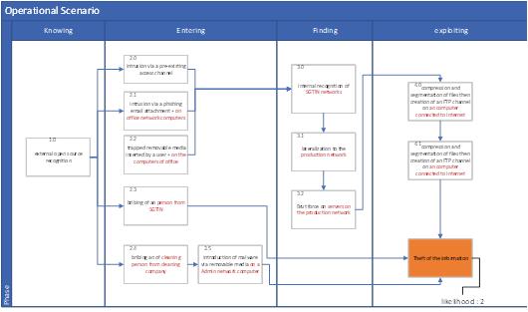
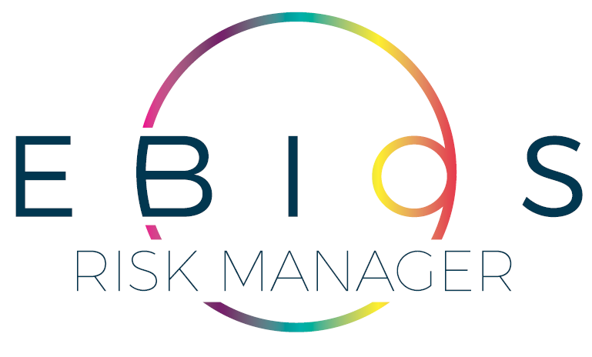
Risk management for complex systems
On one side we have a process of Risk Management for a complex system
Sub-system N
Sub-system 2
Sub-system 1
Strategic scenarios
4
3
Severity
S1
S2
S3
2
1
1
2
3
4
Likelihood
Operational scenarios / Cyber Kill Chain

Slide 5
Vulnerability Management
On another side we have vulnerability management on various sub-systems
Sub-system N
Sub-system 2
Sub-system 1
Vuln | Value
Vuln 1 | 10
Vuln 2 | 5
… | …
Vuln N | 3

Slide 6
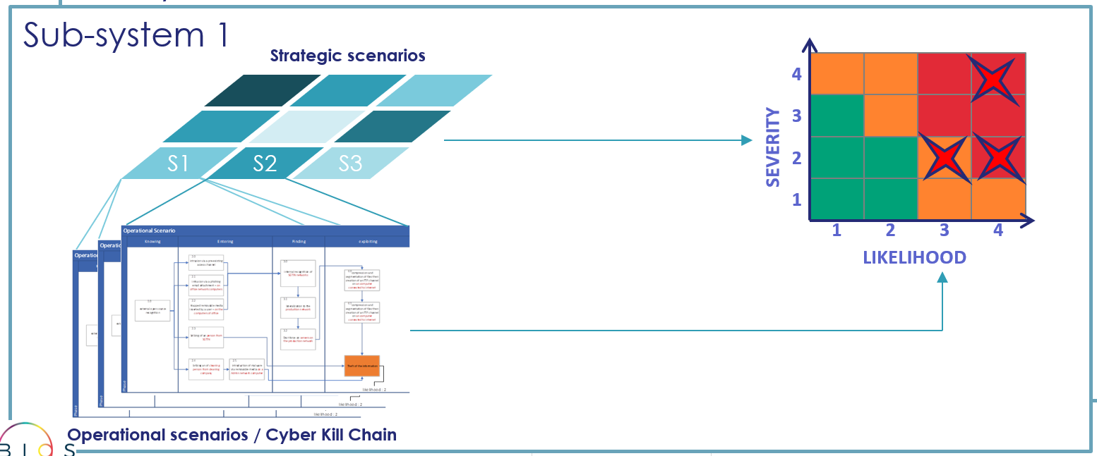

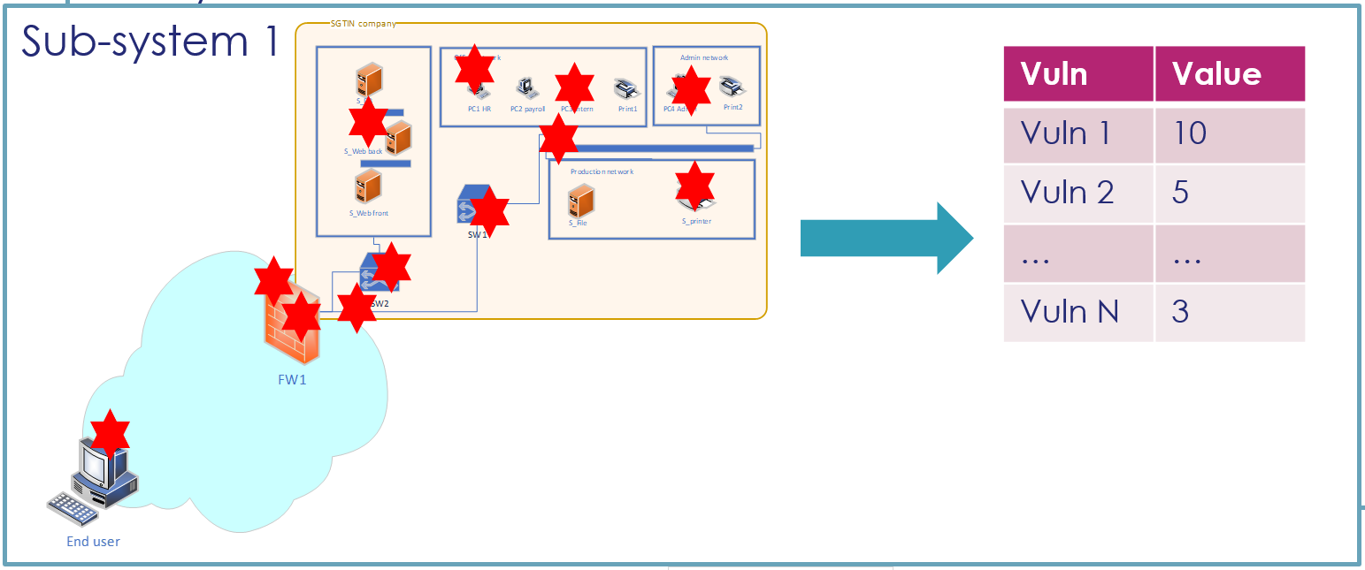
Link Risk Management and Vulnerability Management
Risk Management
<
<<<<<<<<<<<<<<
Operational Scenarios Data Base (DB)
  Normalise the data
Vulnerability Management
Vulnerabilities DB
Architecture in CMDB
(Configuration Management DB)

Slide 7
Tool use case – Overview
Operational scenario Step
<<<<<<<<<<<<<<
Operational Scenarios Data Base (DB)
Technique
Supporting asset
Vulnerability
Vulnerabilities DB
CMDB

Slide 8
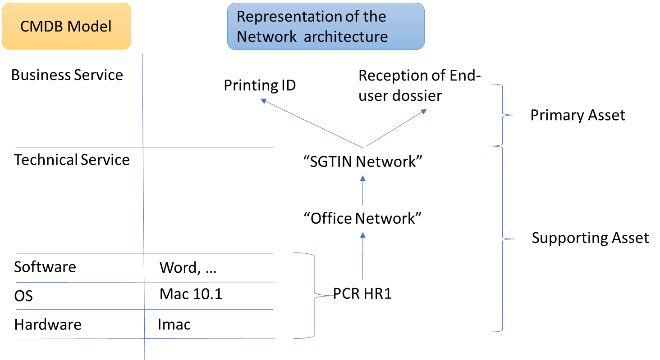
Definition of the tool
Set up of Configuration management database
Architecture in CMDB
(Configuration Management DB)
Network Map
CMDB
IT Asset Database

Slide 9
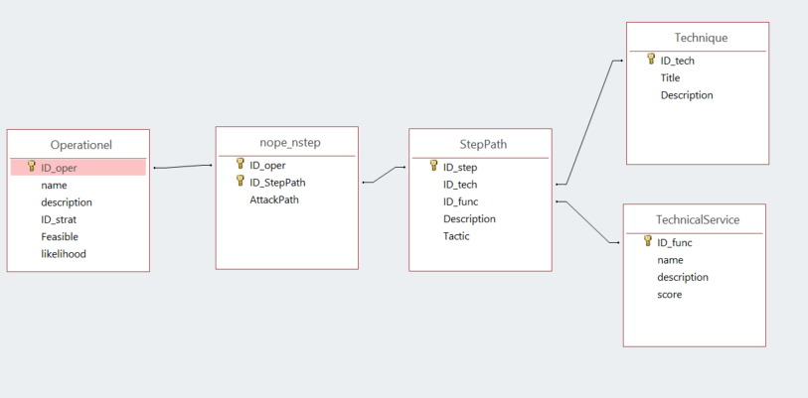
Definition of the tool
Set up of Operational scenario database
Operational Scenarios Data Base (DB)
Operational scenario from risk analysis
Operational scenario step 2.2
Technique
Operational scenario Step
Supporting asset

Slide 10
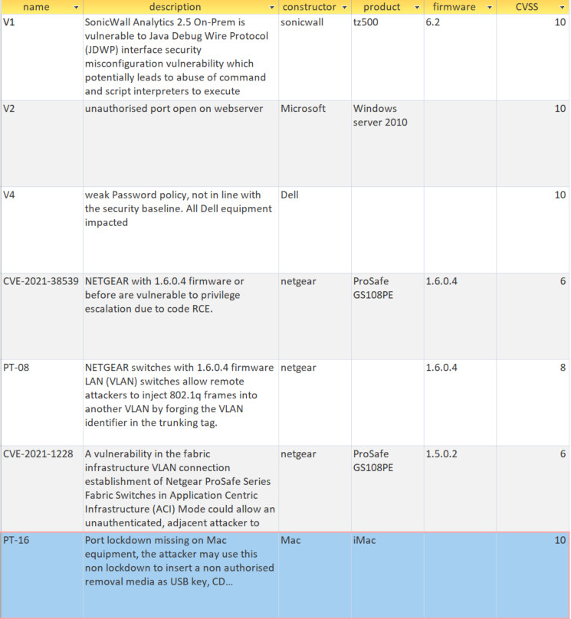

Definition of the tool
Set up of Vulnerability database
Vulnerabilities Data Base
  Publicly disclosed vulnerability
  Penetration test/audit reports
  Non-Compliance – Security baseline

Slide 11
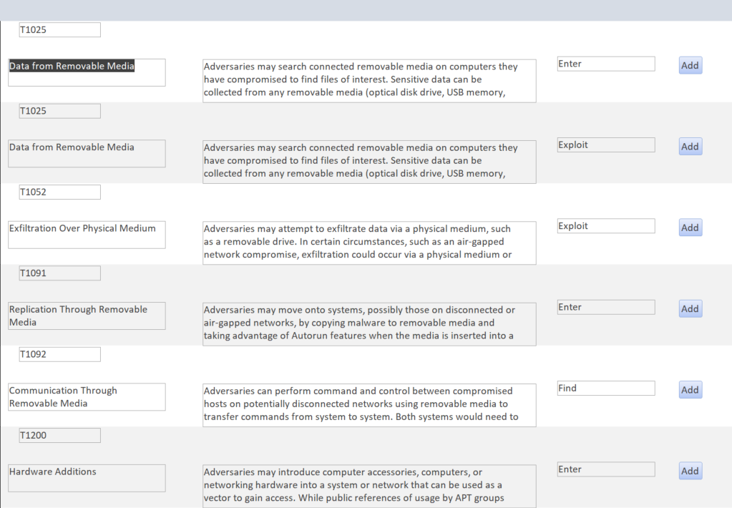
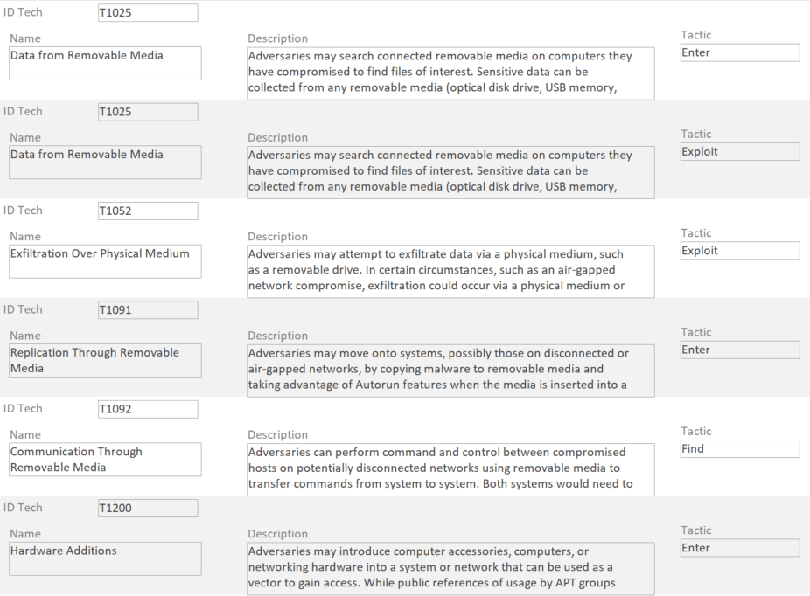
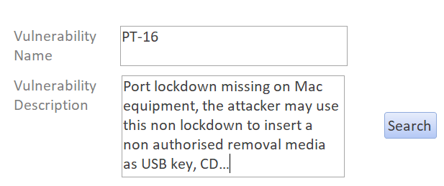
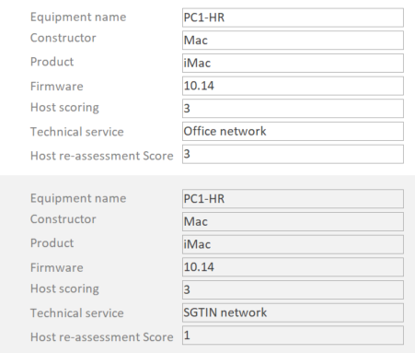
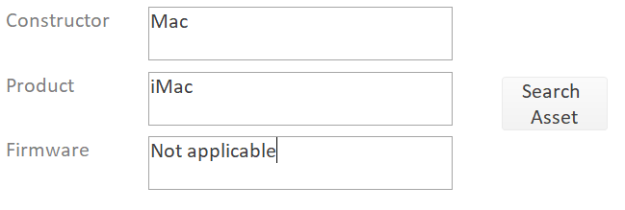
Tool use case – How to do the link between…
1- Vulnerability to techniques
Key words association
Technique
Vulnerability
2- Vulnerability to assets
Supporting asset

Slide 12
Tool use case – Operational step triggered?
Does the vulnerability affect a scenario?
Technique
Vulnerability
Operational scenario Step
Supporting asset
  Query

Slide 13
Tool use case – Likelihood re-assessment
Update of the Operation scenario likelihood

Slide 14
Conclusion
Tool to connect vulnerabilities to enhance risk management
  Improve operational risk scenarios with vulnerabilities
Way forward
  Improve the normalization of the data.
  Use risks to enhance vulnerabilities prioritisation.
  Switch from assisted security expert for likelihood computation to an automatic computation.

