Slide 1


Network automation and security
Jean-Michel Farin
David Roy
Orange France return of experience

Slide 2
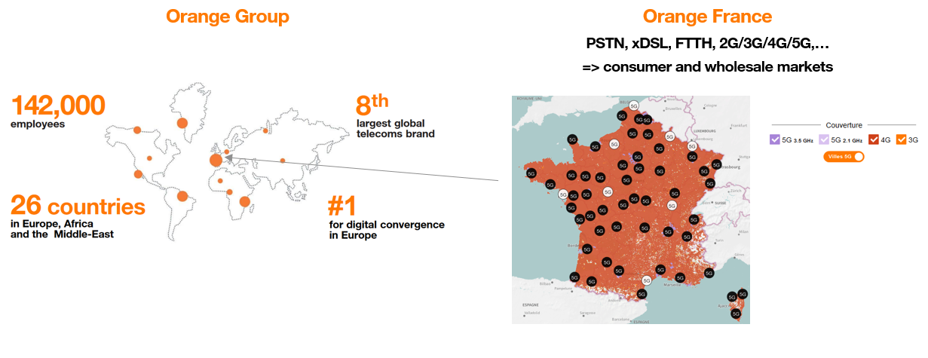
Orange France

Slide 3
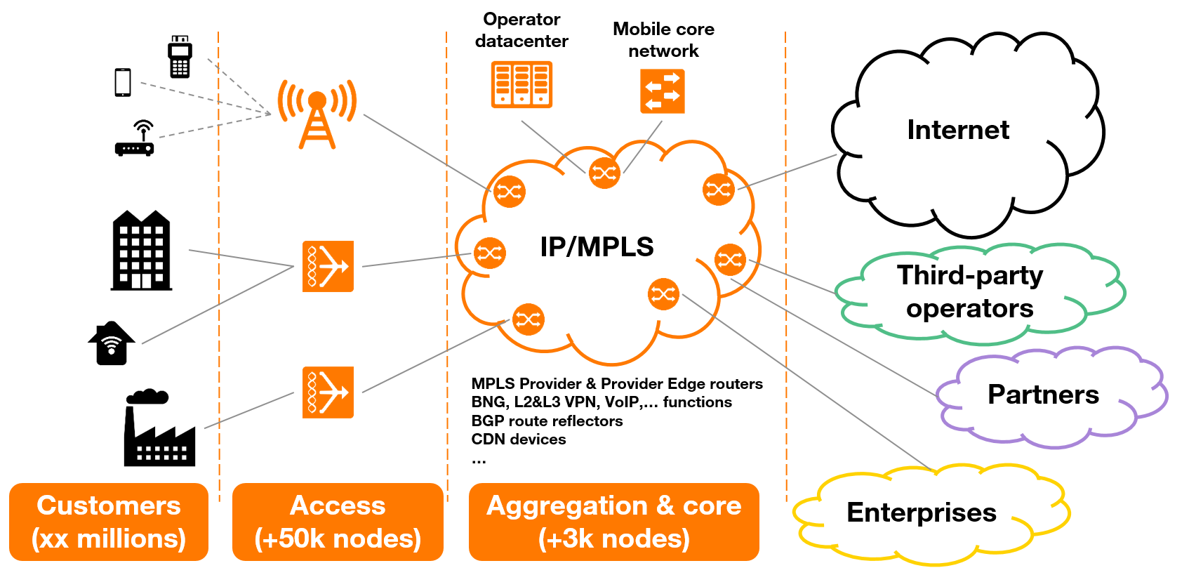
Orange France network

Slide 4
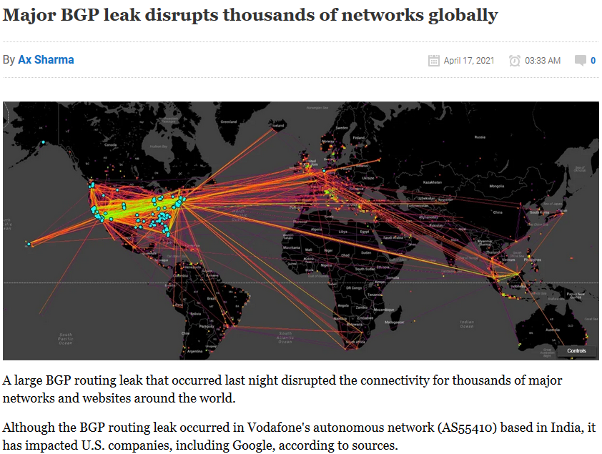
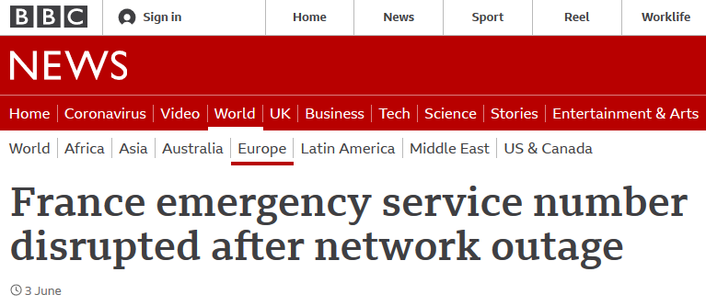

Network incident => crisis

Slide 5
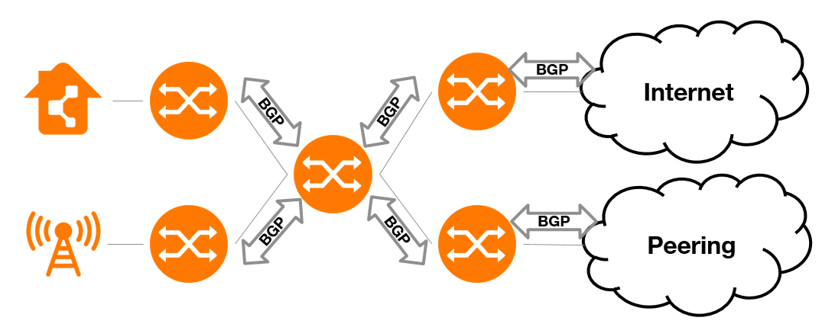
Propagation of network compromise from first equipment

Slide 6
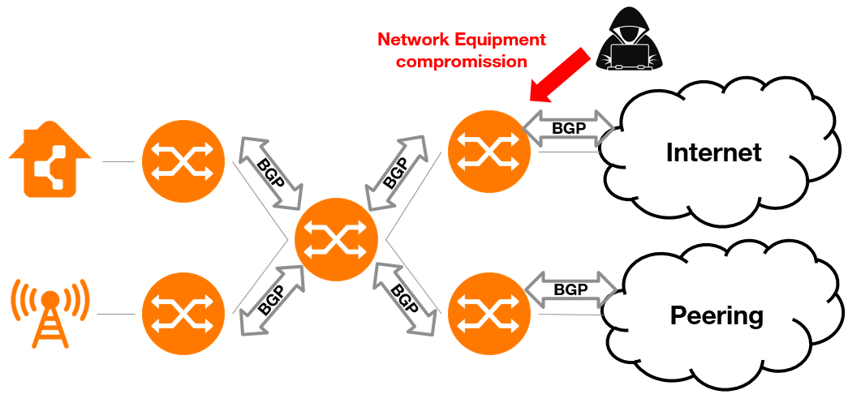
Propagation of network compromise from first equipment

Slide 7
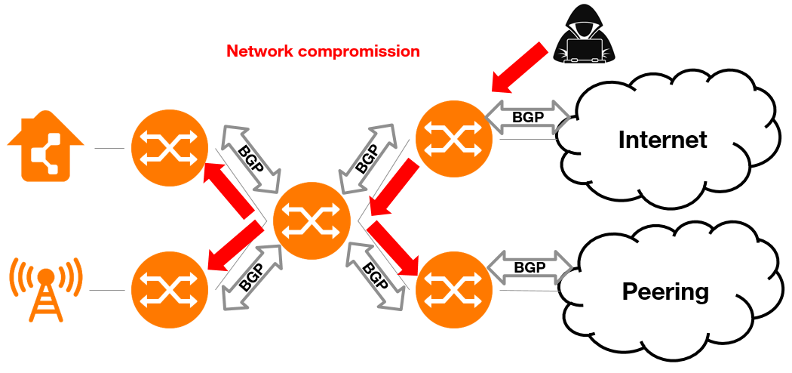
Propagation of network compromise from first equipment

Slide 8
Attacks on network equipment

Slide 9
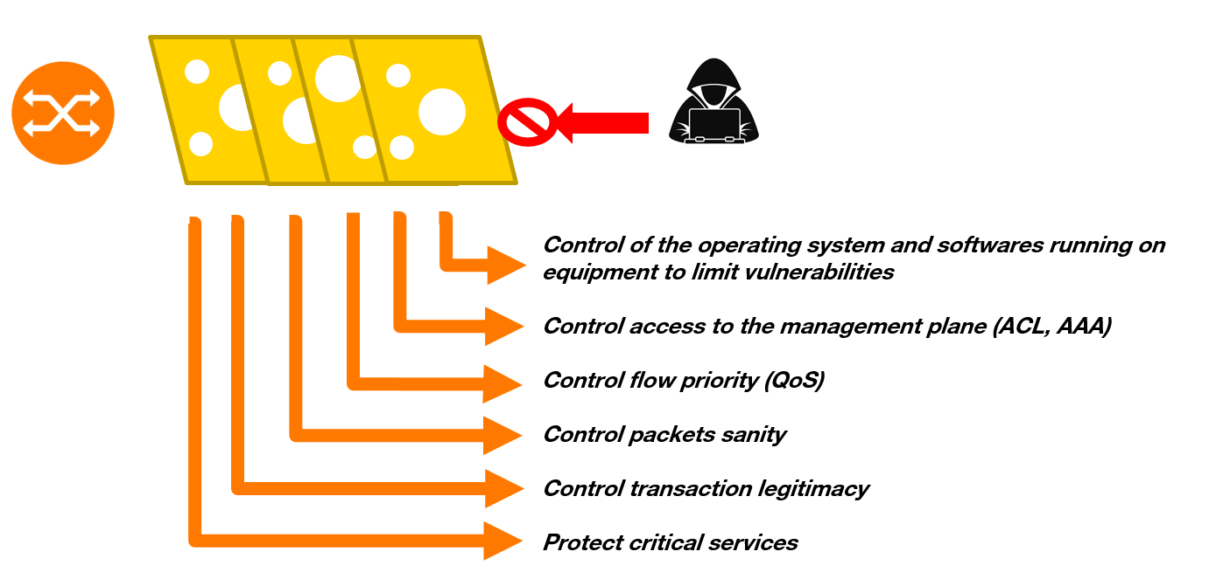
Multiply controls to ensure protection

Slide 10
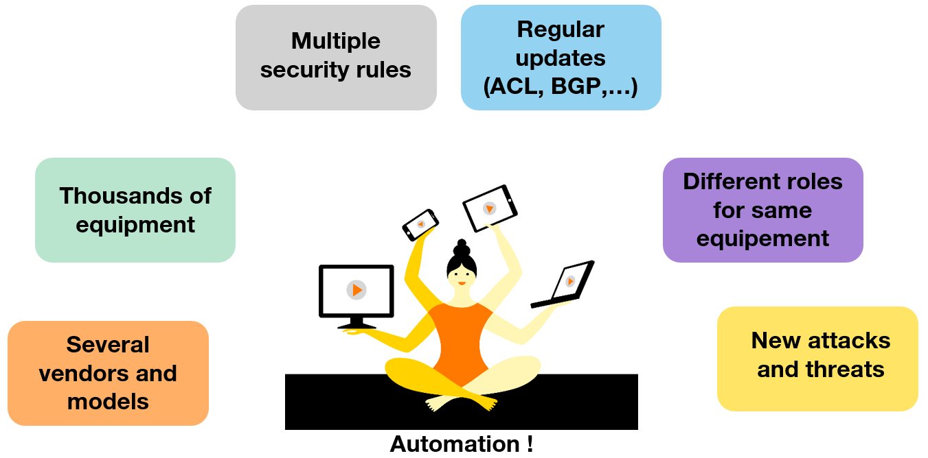
How to manage that?

Slide 11
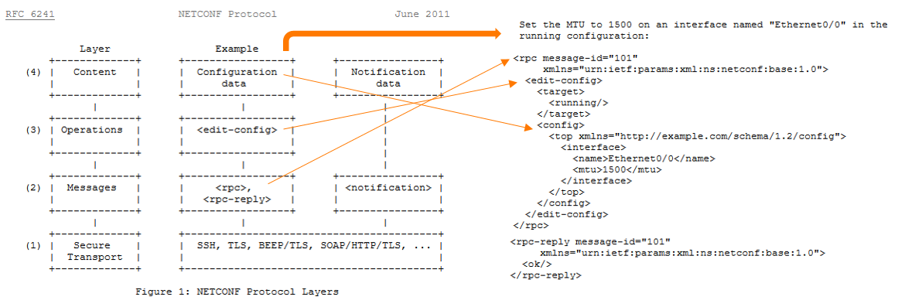
Netconf

Slide 12
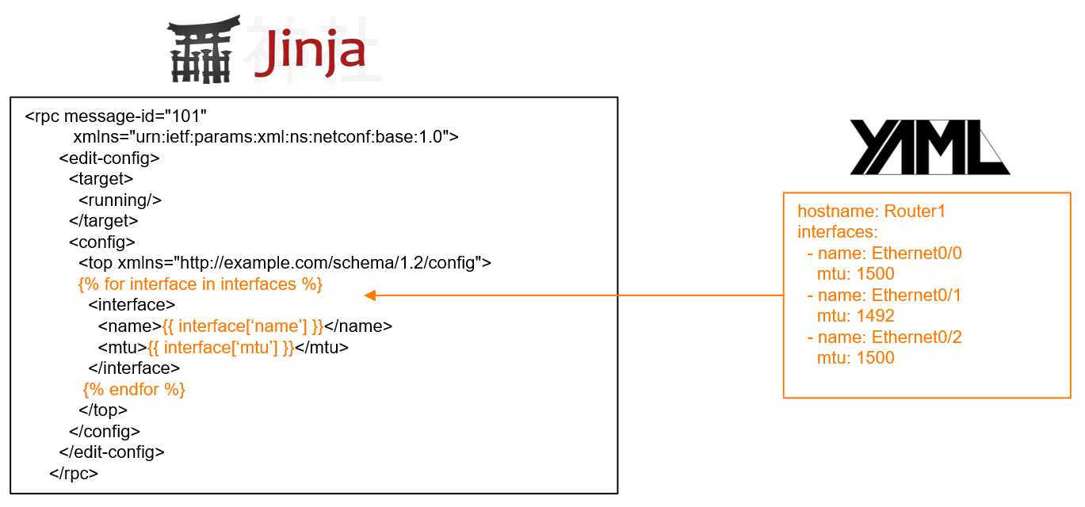
Jinja2 & YAML

Slide 13
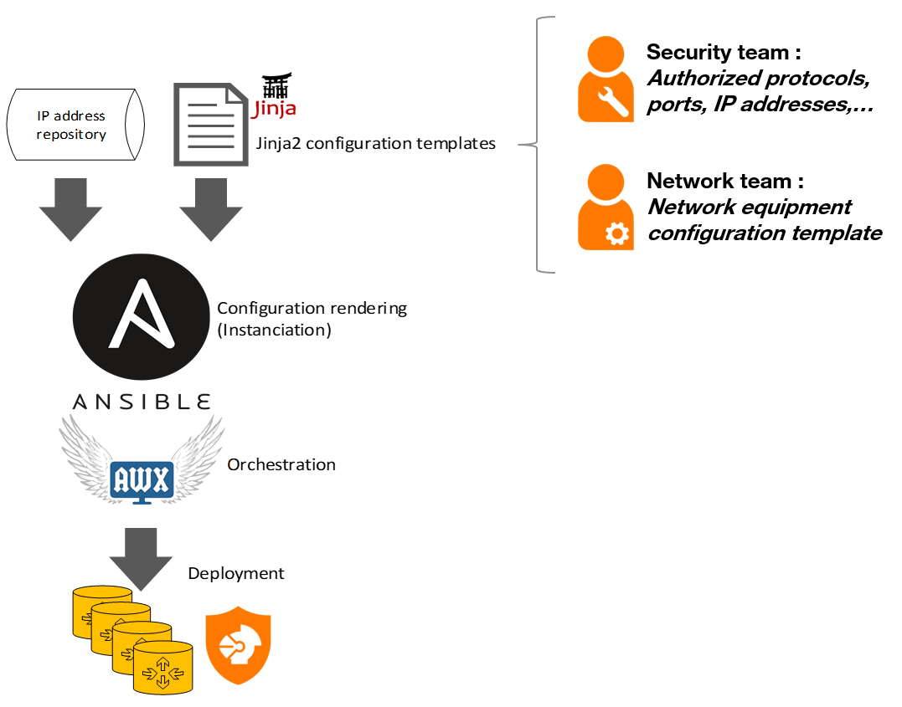
Netconf + Junja2 + YAML + Ansible/AWX

Slide 14
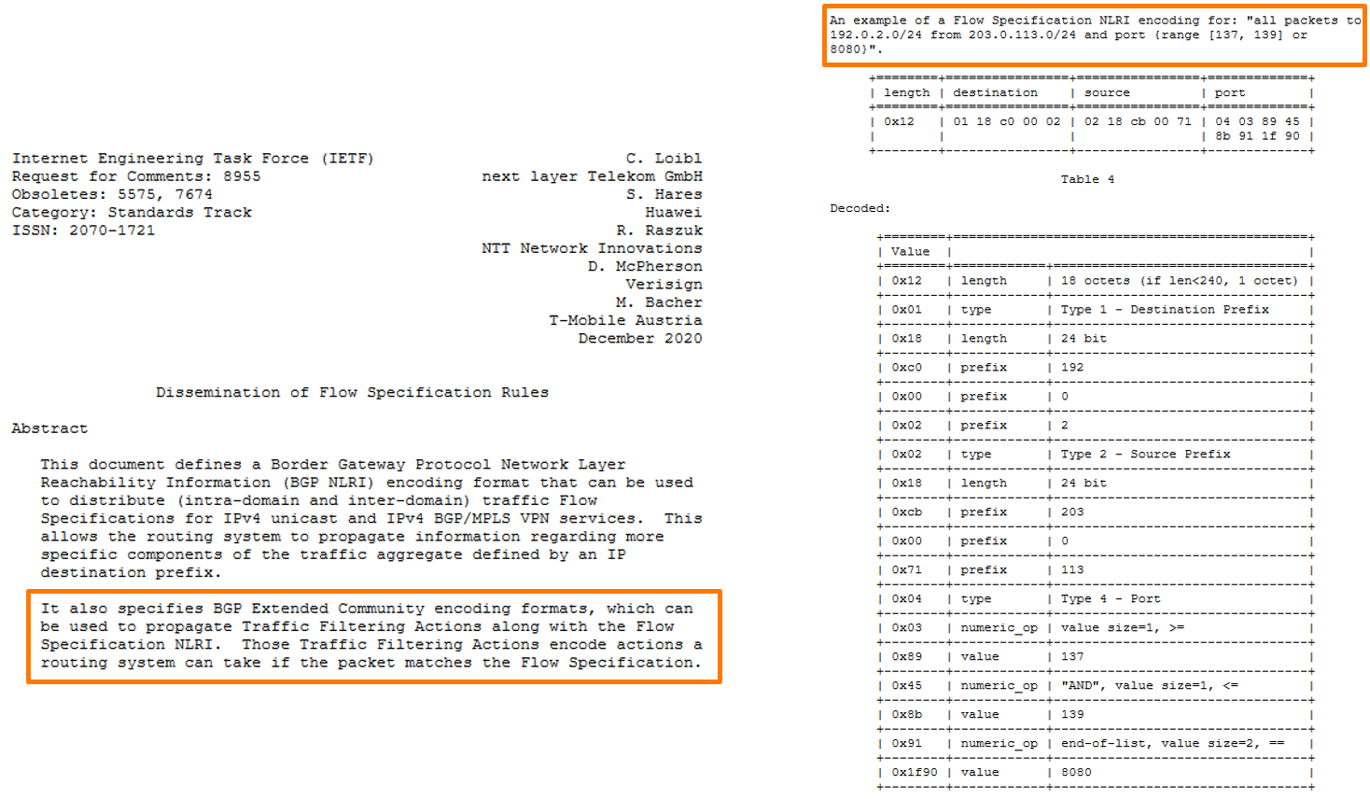
Flowspec

Slide 15
Netflow, Netconf & BGP Flowspec for DDoS protection

Slide 16
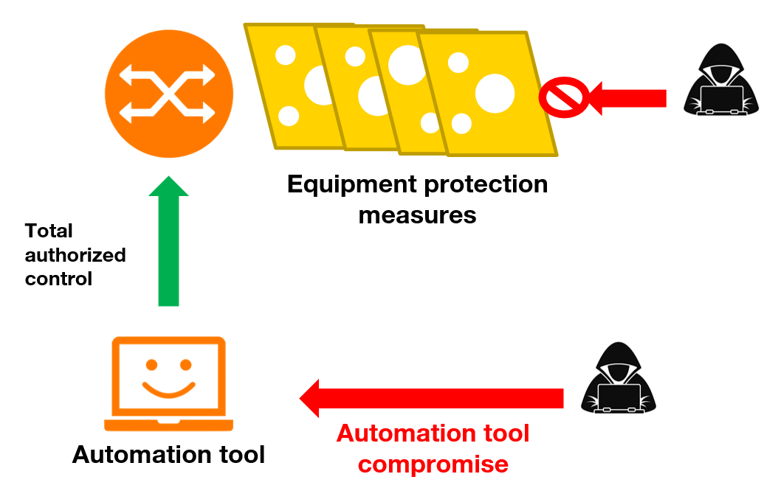
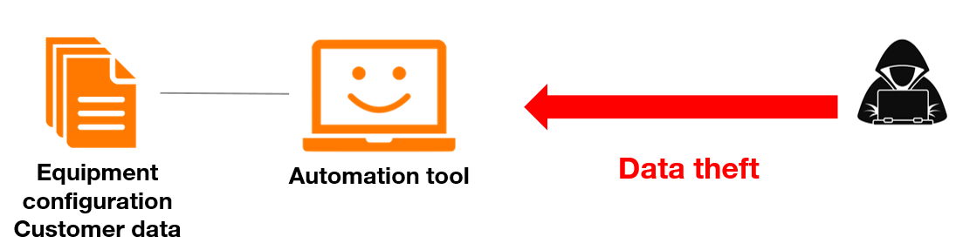
Risks related to network automation

Slide 17
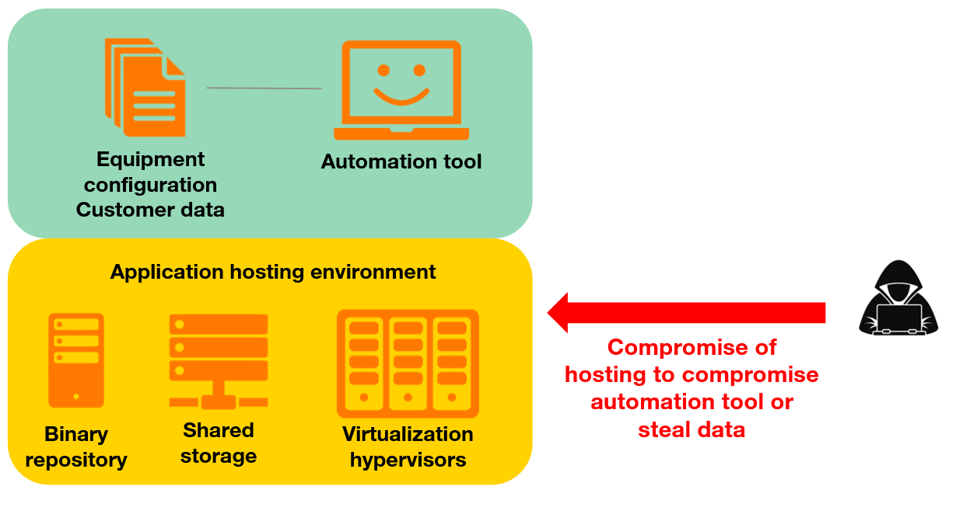
Risks related to network automation

Slide 18
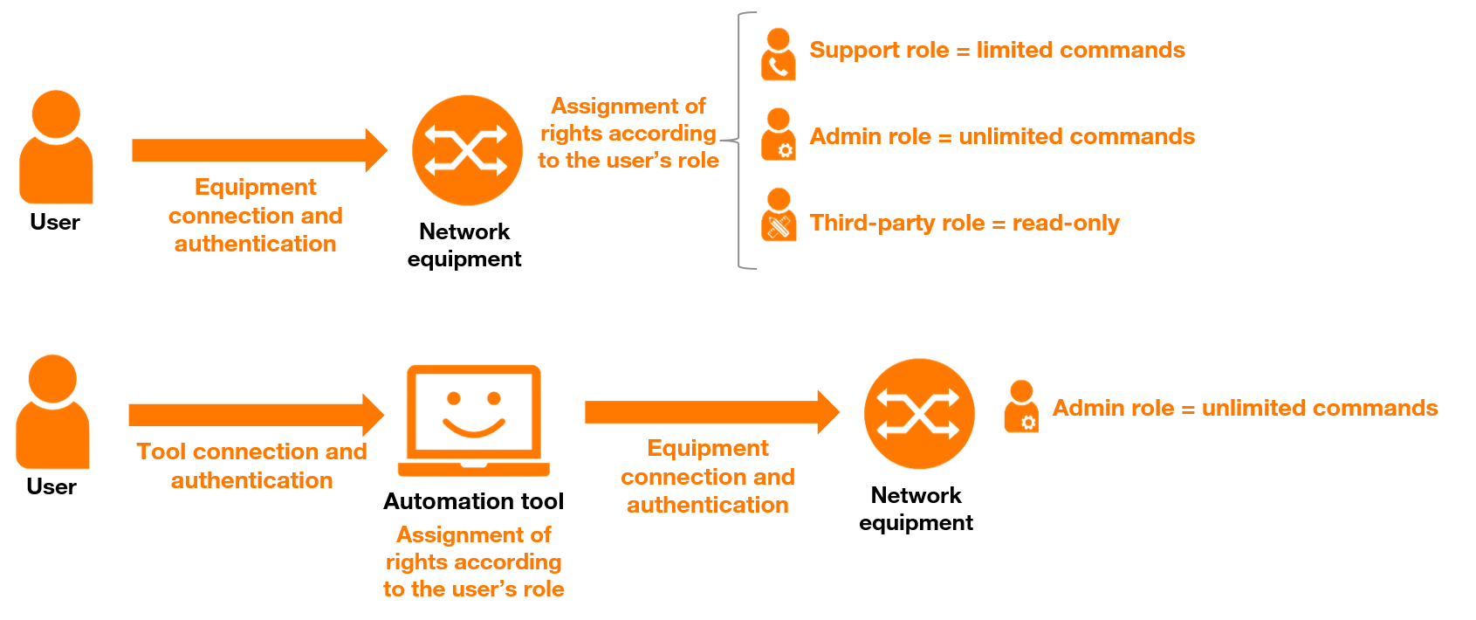
Good security practices for network automation: RBAC

Slide 19
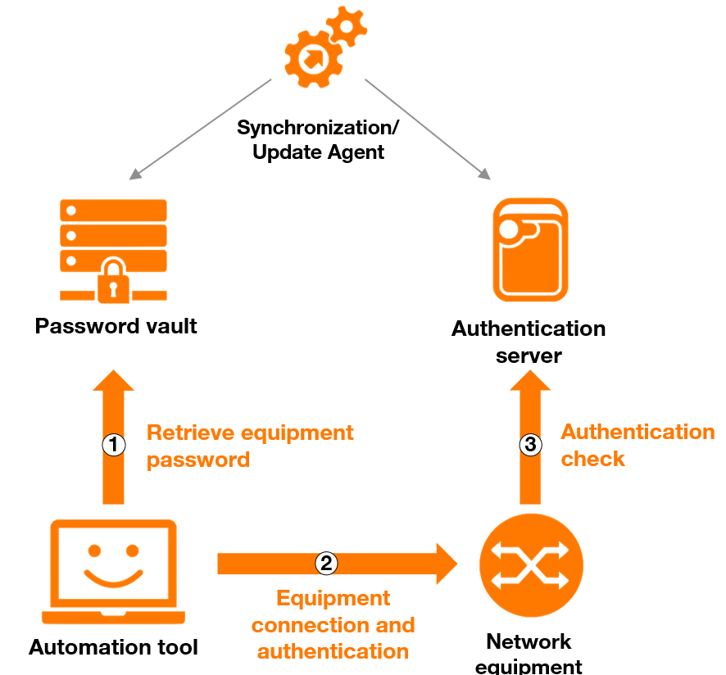
Good security practices for network automation: passwords/keys

Slide 20
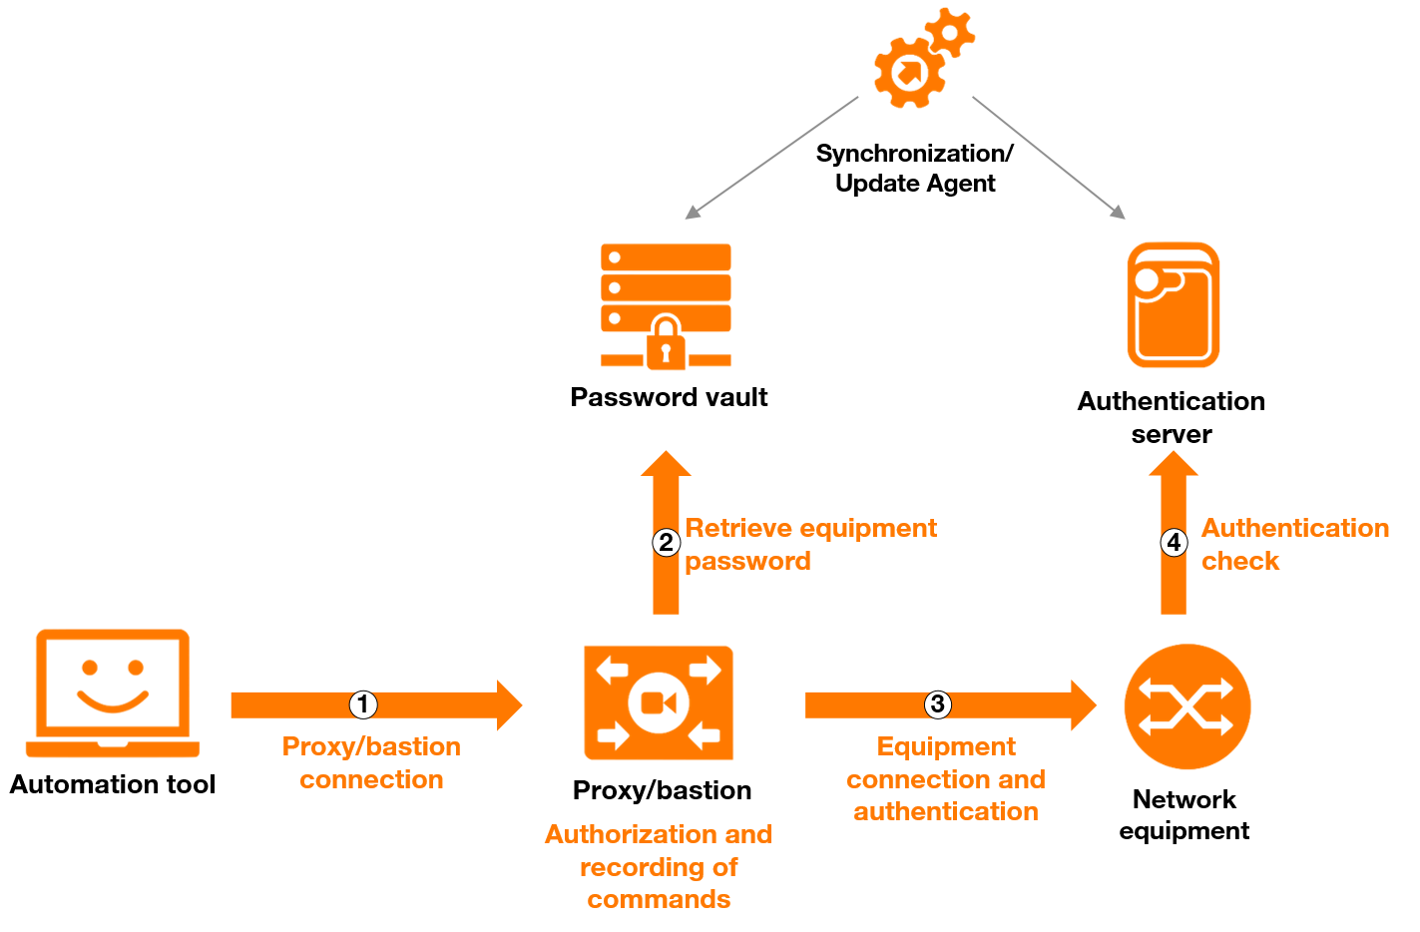
Good security practices for network automation: network access

Slide 21


Conclusion
Network is complex and critical…
Network security is complex and critical !
Automation tools are increasingly needed to ensure the availability, integrity and confidentiality of the network.
To guarantee security the same requirements must be applied to tools as to network equipments!
Cooperation of all involved people is the key (network, security, IT, dev,…).

Slide 22
Thank you
Questions?
Jean-Michel Farin
David Roy

