Slide 1
Attack Forecast and Prediction
Kaiser Florian; Budig Tobias; Goebel Elisabeth; Fischer Tessa; Muff Jurek; Wiens Marcus; Schultmann Frank

Slide 2
Introduction
Attackers seem to have a first mover advantage^{[1]} in a „dynamic cat and mouse game“^{[2]}
A main goal should be the minimization of this first mover advantage - Attack forecasting and prediction however is only hardly used^{[3]}
Projecting and predicting future developments furthermore is oftentimes based on experiences, subjective perceptions and gut feelings of experts
Prone to biases
Time consuming
Low levels of automation in attack forecasting
Notes:
Three levels of cyber-situational awareness
Monitoring of systems and intrusion detection
Understanding the current situation and its implications for cyber security
Projecting and predicting future developments
Experienced experts are rare and there time is even scarcer → automation is a significant contributor to decreasng the attackers first mover advantage

Slide 3
Motivation
“Although many solutions have been proposed, there is still no definite answer on how to effectively and precisely predict cyber attacks.”^{[3]}
Predictions mainly focus on a short term horizon rather than a medium- to long-term horizon
Attack prediction and forecasting “is still an open and an imperative, desirable research problem”^{[3]}

Slide 4
Cyber Threat Intelligence
Cyber Threat Intelligence (CTI) defines structured, actionable information for identiying adversaries and their motives, goals, capabilities, resources and tactis.^{[2]}
Powerful means of increasing the efficiency and automation of various security solutions
CTI can be used for automated reasoning (data driven analytics) in cyber risk management
→ Threat Hunting; Attack detection; Attack prediction; Forensic investigations
Technical CTI
Operational CTI
Tactical CTI
Strategic CTI
Objectives
Levels
CTI
Importance of CTI lies in itst ability to share threat information among partners ^{[2]}
→ steamlined and structured information sharing
→ Structured Threat Information eXpression (STIX language) as a standard language for sharing CTI
Formats
Notes:
Information extracted from CTI improves the analyst‘s ability to recognize relevant threats and respond to them in a timely manner

Slide 5
Research objectives
Can any patterns or trends be extracted form CTI and used for crafting strategic medium to long term predictions on the threat landscape?
How do different algorithms perform to predict future malware in a medium to long term?
Can graph analytics be used to increase automation and precision in attack prediction and forecasting
01
Contributions
Utilizing CTI to infer automatically and improve hypotheses on new attacks
Achieving a higher level of automation by automatic construction of hypotheses, supporting the analyst‘s decisions, saving scarce time
Improving the accuracy of hypotheses provided by an analyst (minimizing biases due to subjective perspectives)
Providing medium- to long-term predictions
Notes:
The purpose of the present paper is the design and construction of a multilevel threat ontology called AttackDB and Attack Hypothesis Generator (AHG)
AttackDB fuses thata from MITRE ATT&CK Enterprise knowledge base,1 the AlienVault Open Threat Exchange,2 the IBM X-Force Exchange,3 and VirusTotal.
Through high-level reasoning on multilevel threat ontology, AHG provides full descriptions of attacks by complementing yet undetected attack patterns
The ability of AHG to complement the descriptions of attacks is a critical step toward increasing the automation level of forensic investigations

Slide 6
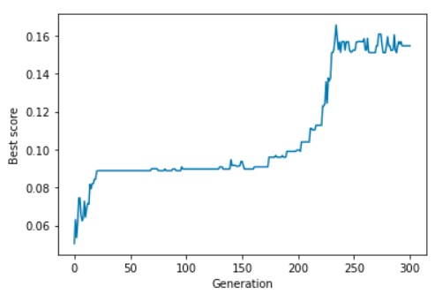
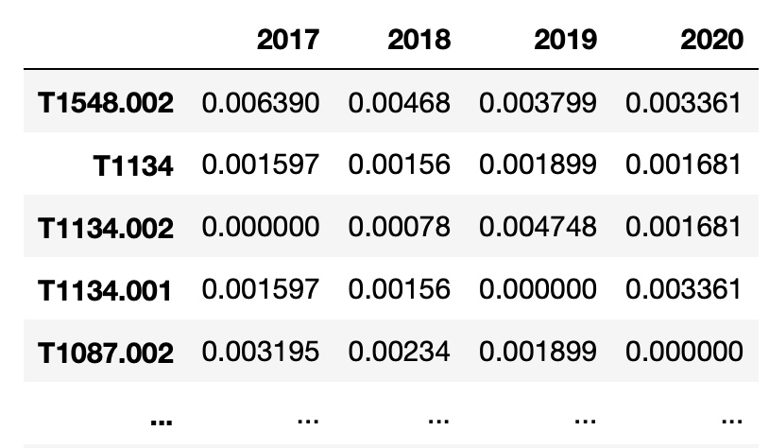
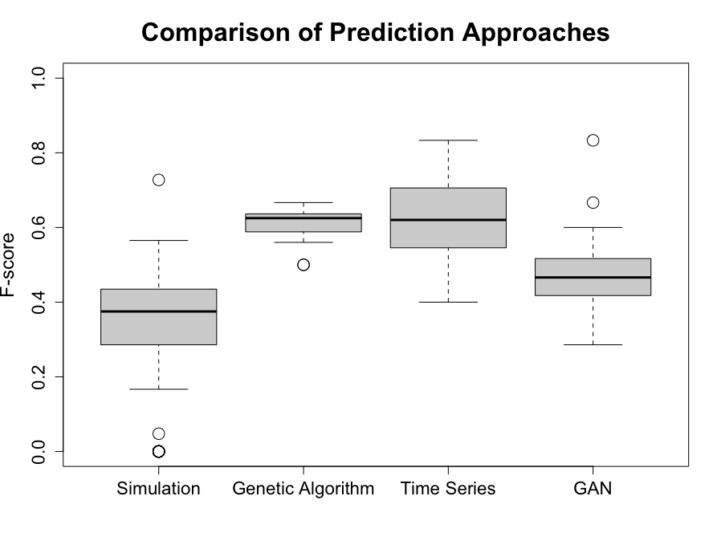
Methodology
Cyber threat knowledge graph
Generating test and training dataset
Attack Forecast and Prediction
Evaluation
Notes:
Scraping CTI and crafting a multi-layered attack knowledge graph
Time sorting the evidence and crafting a training and a test dataset
Predicting new malware-nodes within the attack knowledge graph based on the training data set
Evaluating them based on the test dataset

Slide 7
Cyber Threat Knowledge Graph
Multi-level threat ontology based on CTI scraped from MITRE ATT&CK
Analyzed relying on different algorithms for graph analytics for crafting attack predictions and forecasts
Each Malware (M) can be described as a combination of techniques (T)
Statistics
MITRE ICS, Enterprise & Mobile
13 tactics
552 techniques
585 different softwares (malwares)
M1
M2
M3
T1
T2
T3
T4
T5
T6

Slide 8
Dataset splitting
Excluded „degenerated“ malware
449 remaining attacks – malware
Data was time sorted
80/20 - splitting
Training set: 358 oldest attacks of
- 31.5.2017 - 10.6.2020
Test/ evaluation set: 91 newest attacks
- 10.6.2020 - 13.4.2021

Slide 9
Algorithms for forecast and prediction generation
Classical graph analyric algorithms
Hierarchical Clustering
Principal Component Analysis
Time series and regression analysis
Genetic algorithms
Fitness derived from technique utilization as a proxy for the promissed utility (frequency & correlation)
Roulette wheel selection & tournament selection
Uniform crossover, one point crossover, two-point crossover
Neural network
Generative adversial network

Slide 10
Evaluation
Walk forward validation (1 year ahead)
Test dataset consisting of historic attacks from since 2020
F-Score
$$F=2∙\frac{p ∙ r}{p+r}$$
Baseline
„Simulation“ – extrapolation based on current observations

Slide 11
Conclusion
AFP is an automated attack predictor able to forecast new malware developments
Showed and validated the predictive power based on walk forward validation with a time horizont of one year
Predictions are not exact rather, real software deviates slightly from most predictions
AFP increases cyber security maturity and cyber situational awareness through ist high predictive capability
The results of AFP can be used to prepare proactively for future attacks and improving investment decisions/ research spending of defenders, develop security measures before they were observed in the wild.
AFP suffers from data quality and low data availability

Slide 12
Thank you for your attention
M. Sc. Florian Kaiser
Research Associate
Karlsruhe Institute of Technology (KIT)
Institute of Information Security and Dependability & Competence Center for Applied Security Technology (KASTEL)
florian-klaus.kaiser@kit.edu

Slide 13
References
[1] Hausken, K., & Bier, V. M. (2011). Defending against multiple different attackers. European Journal of Operational Research, 211(2), 370-384.
[2] Elitzur, A., Puzis, R., & Zilberman, P. (2019, November). Attack hypothesis generation. In 2019 European Intelligence and Security Informatics Conference (EISIC) (pp. 40-47). IEEE.
[3] Husák, M., Komárková, J., Bou-Harb, E., & Čeleda, P. (2018). Survey of attack projection, prediction, and forecasting in cyber security. IEEE Communications Surveys & Tutorials, 21(1), 640-660.

