Slide 1
&
Large Scale Automation of Binary Analysis: From Open Source Collection to Threat Intelligence
Marie Salmon – Sébastien Larinier – Frédéric Grelot

Slide 2
Data collection and transformation

Slide 3
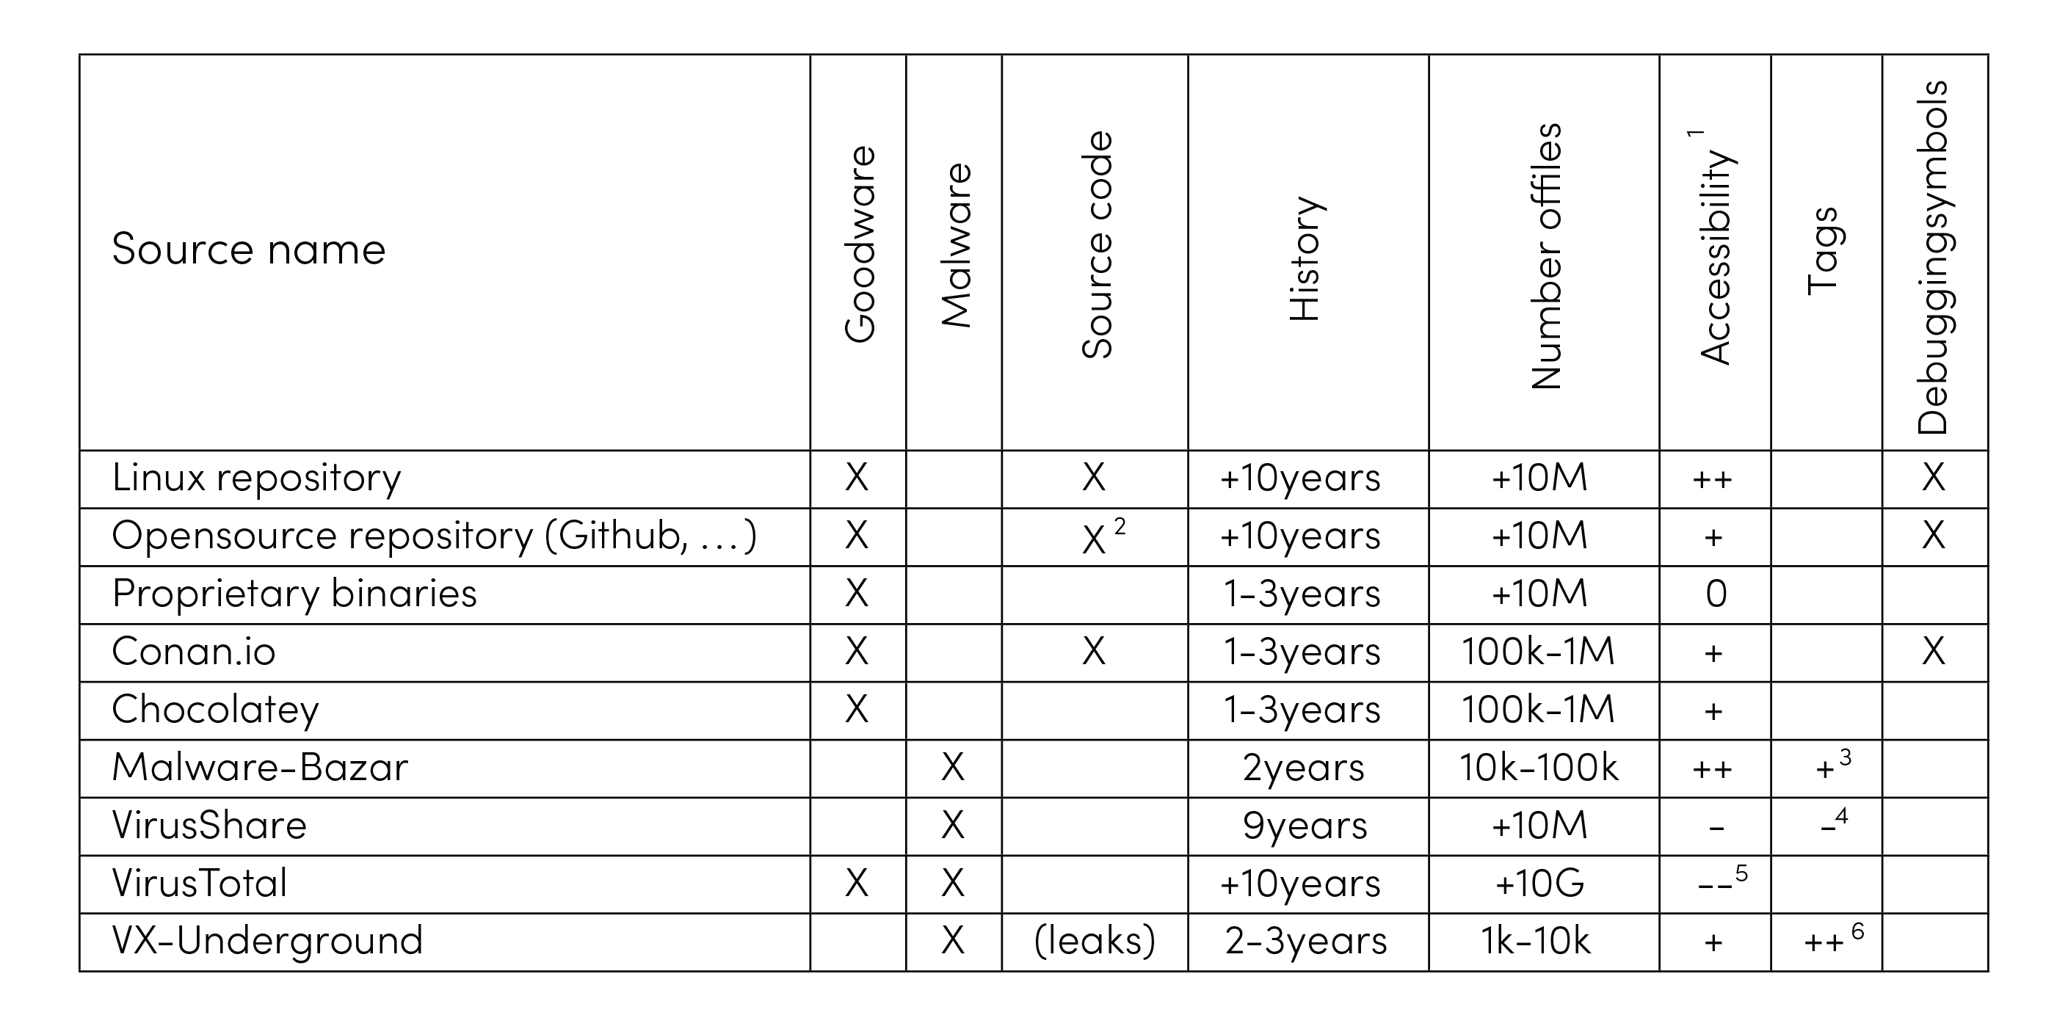
3
“Open” code and binary repositories
¹ Accessibility levels from very easy (++) to very difficult (- -). 0 represents a neutral level.
² Compilation often requires manual work.
³ Tags manually assigned by the researchers who feed it.
⁴ Quality of the tags is quite low and often contains only the number and names of detections by antivirus software.
⁵ Have to pay.
⁶ Tags assigned directly by the VX-Underground team.

Slide 4
4

Slide 5
5
Data Analysis

Slide 6
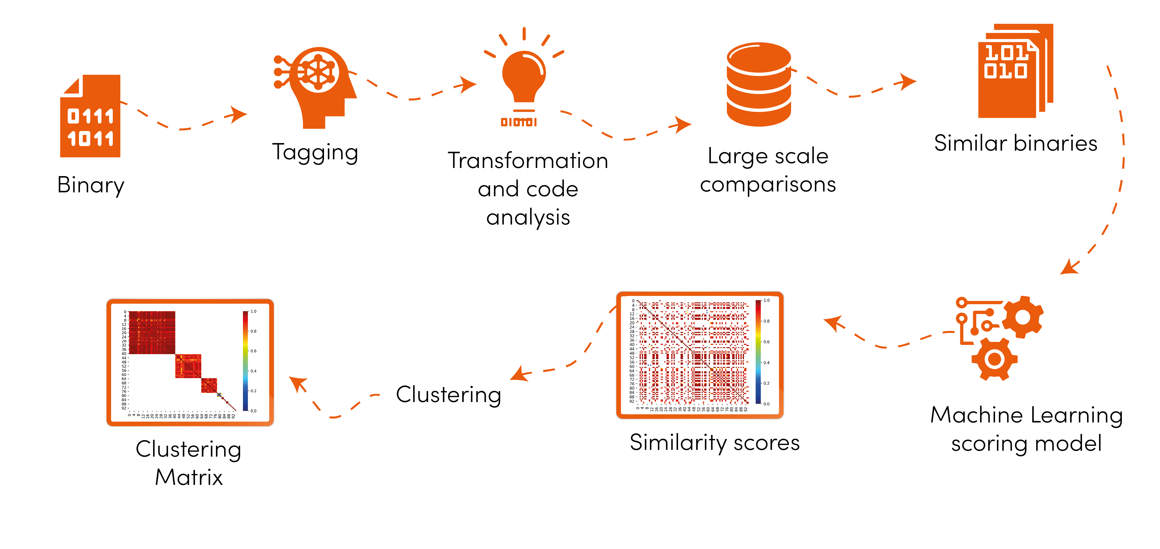
6
Use of similarities between malware

Slide 7
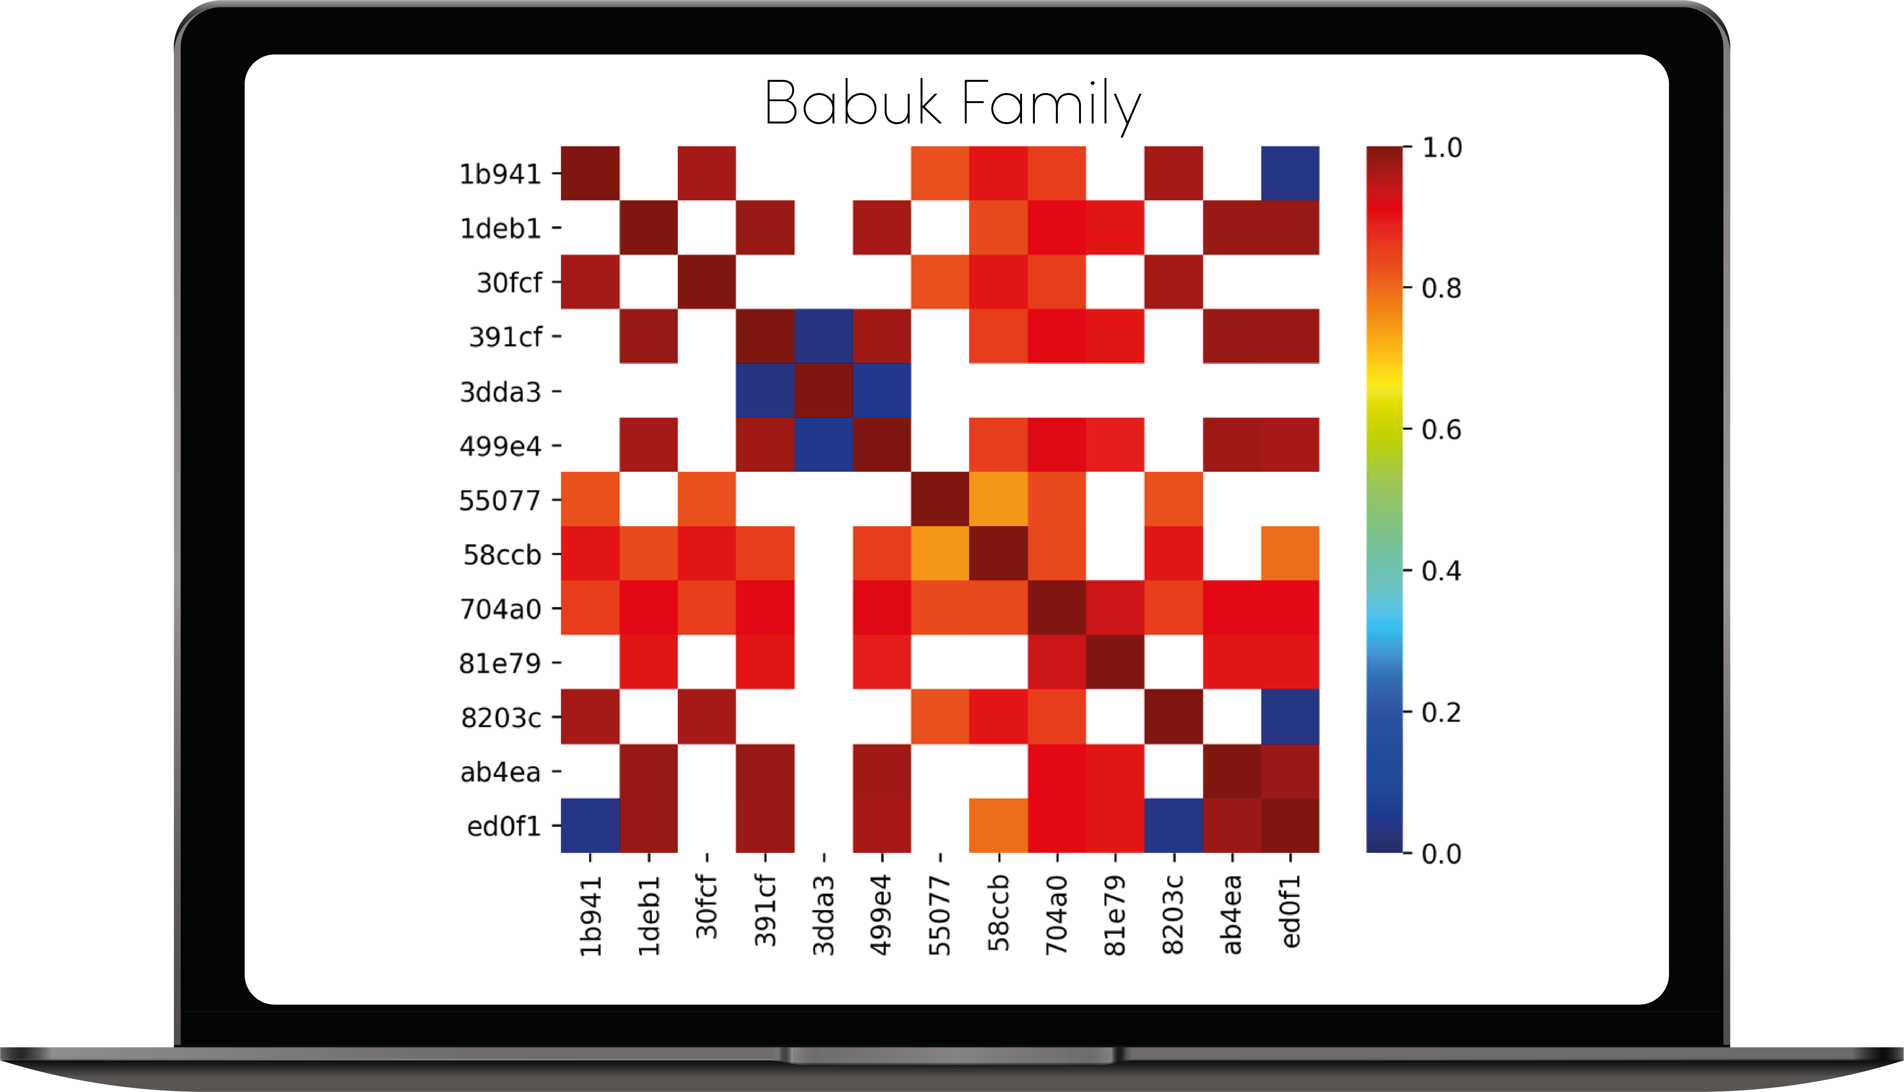
7
Correlation matrix and clustering
Matrix = binaries (by hash) in rows and columns.
Values = similarity scores between binaries from 0 to 1.
Absence of color = no similarity detected.

Slide 8
8
Generation of the clustering
- Input: Correlation matrix
- Using 2 methods in combination:
DBSCAN¹ (density based clustering)
AgglomerativeClustering² (hierarchical clustering)
- Iterative clustering:
1. Generation of initial clusters (using the method with the best clustering),
2. Re-sliced them as long as it improves the global clustering.
¹ M. Ester, H.-P. Kriegel, J. Sander, X. Xu, et al., A density-based algorithm for discovering clusters in large spatial databases with noise., in: Kdd, volume 96, 1996, pp. 226–231.
² https://scikit-learn.org/stable/modules/generated/sklearn.cluster.AgglomerativeClustering.html

Slide 9
9
Evaluation of the clustering quality
Clustering quality = degree of separation and density
Evaluated with the average silhouette coefficient³ of each binary:
a(i): mean distance between binary i and other data points in the same cluster Ci.
b(i): mean distance of i to all points in any other cluster.
Its value goes from -1 to 1.
³ P. J. Rousseeuw, Silhouettes: a graphical aid to the interpretation and validation of cluster analysis, Journal of computational and applied mathematics 20 (1987) 53–65.

Slide 10
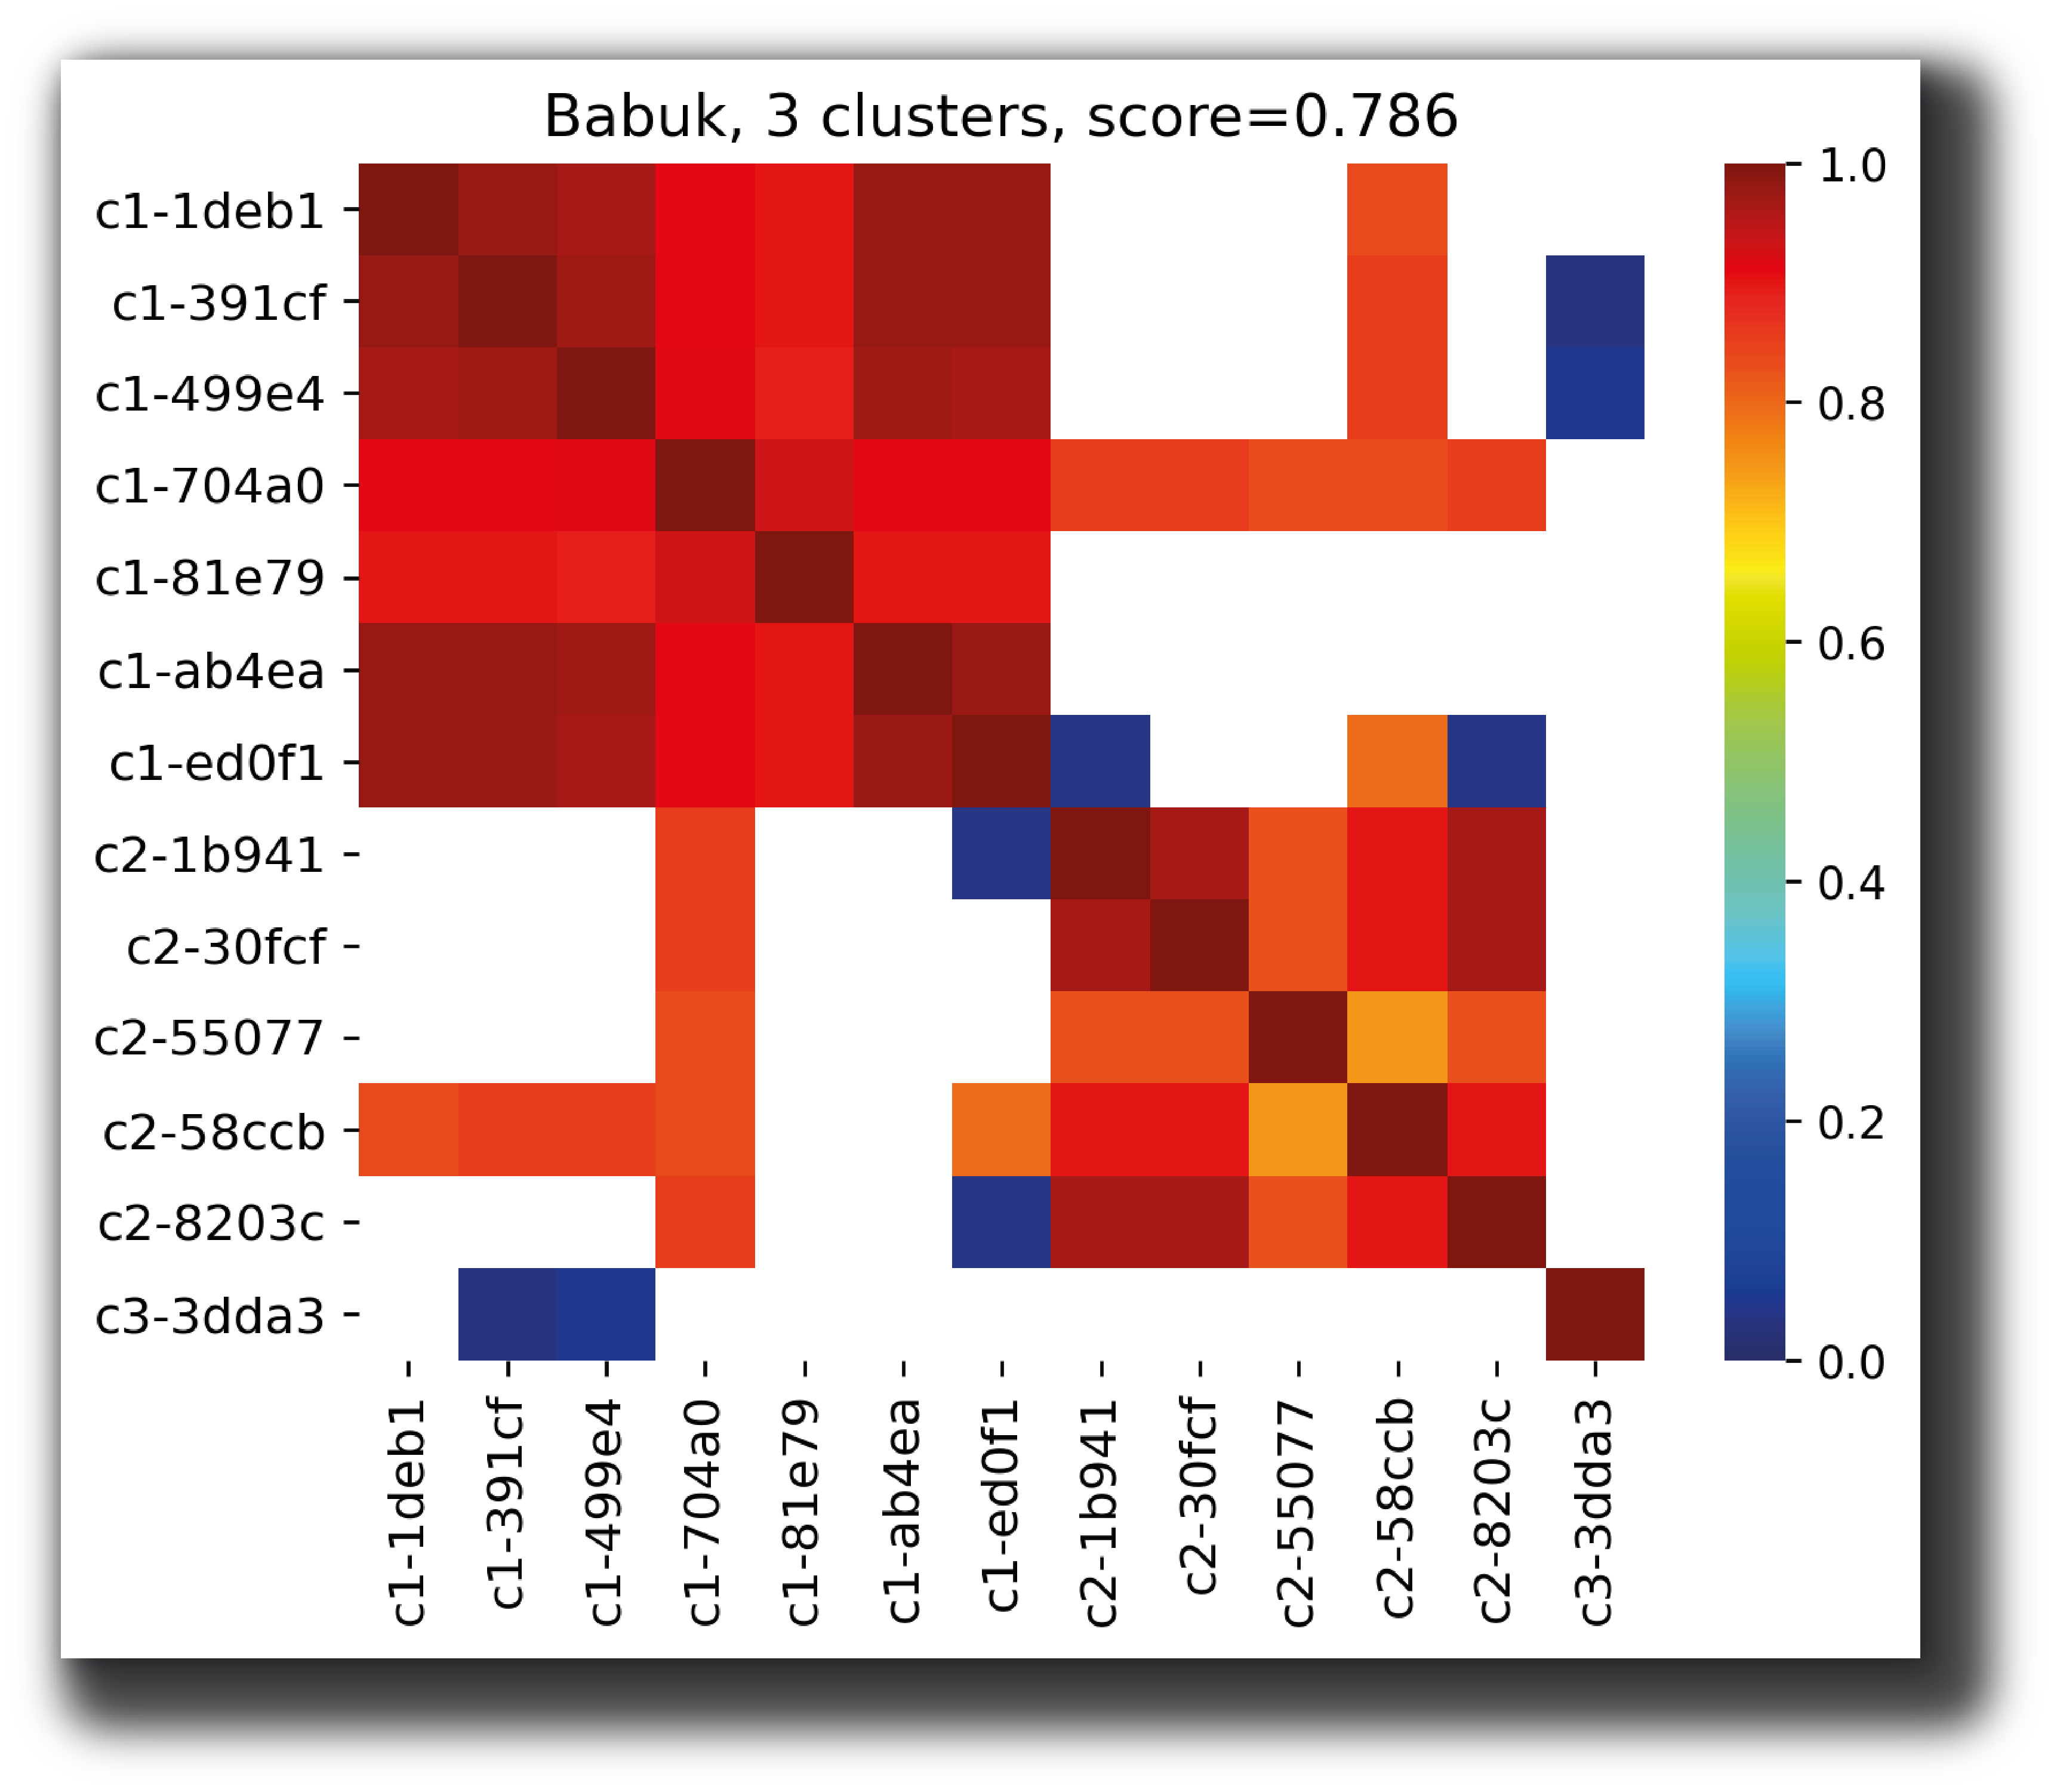
10
Evaluation of the clustering quality

Slide 11
11
Evaluation of the clustering quality

Slide 12
12
Babuk
A new player

Slide 13
13
Timeline
02 Janvier 2020
Leak on Raid Forum
30 Novembre 2020
First sample compiled
Ransomware possibly developed by Russian speaker
03 Janvier 2020
First public analyze by Chuong Dong
22 Décembre 2020
First sample compiled in Virustotal

Slide 14
14
Analysis
Asymmetric crypto algorithm to share the encryption key
Symmetric crypto algorithm to encrypt files
A ransom note explaining how to pay to get the decryption key
Algorithm to parse the filesystem to chose which file to encrypt

Slide 15
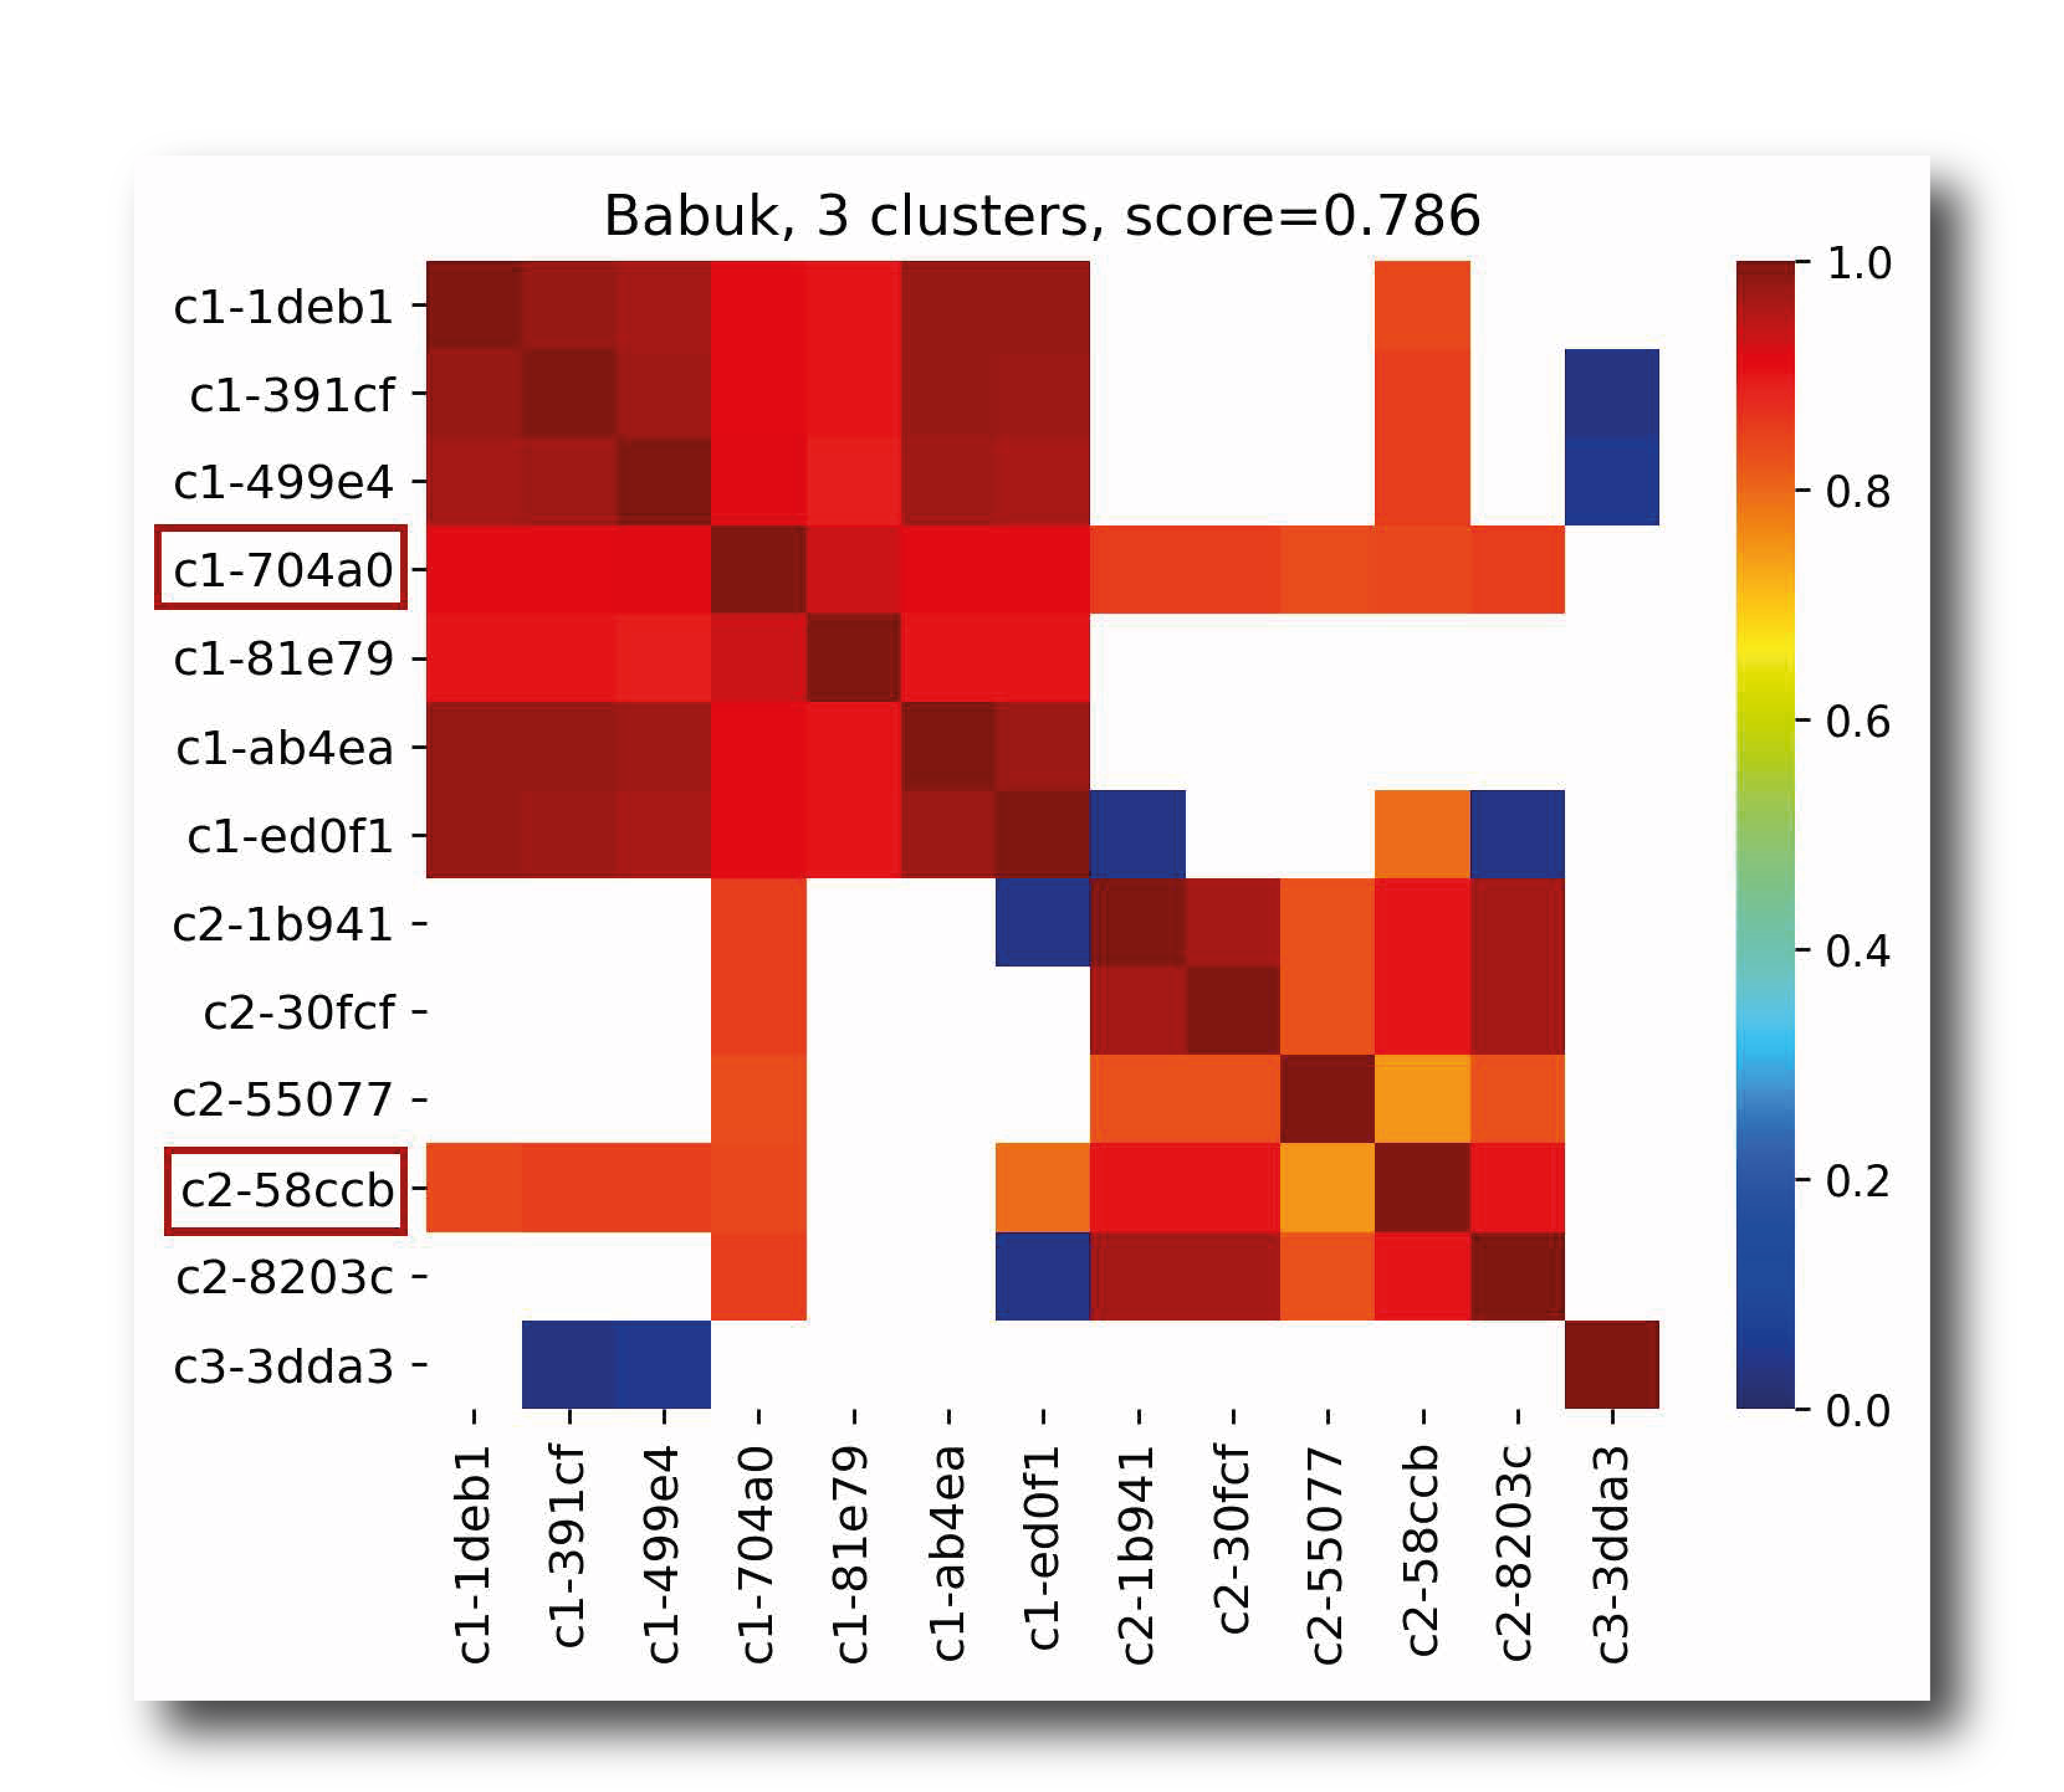
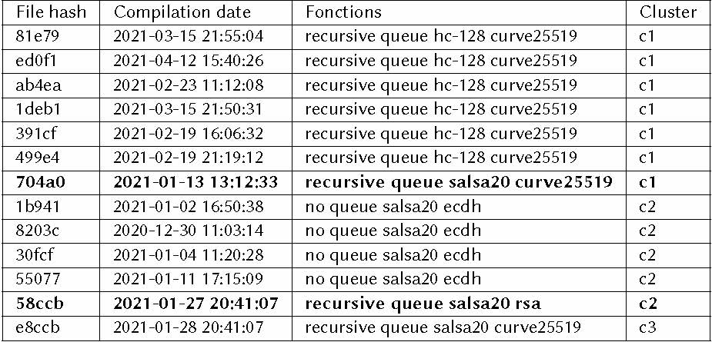
15
Validation of the model

Slide 16
16
Conti & Ryuk
A bigger family

Slide 17
17
History
Ransomware distributed by many affiliates and other gangs (Russians):
Emotet, Trikbot (Wizard Spider)
UNC1878 possible links with TA505
FIN6
Many victims over the world

Slide 18
18
Link with conti
Overlaps of technics described by many vendors
Same ransomnotes templates
Same financiary pattern

Slide 19
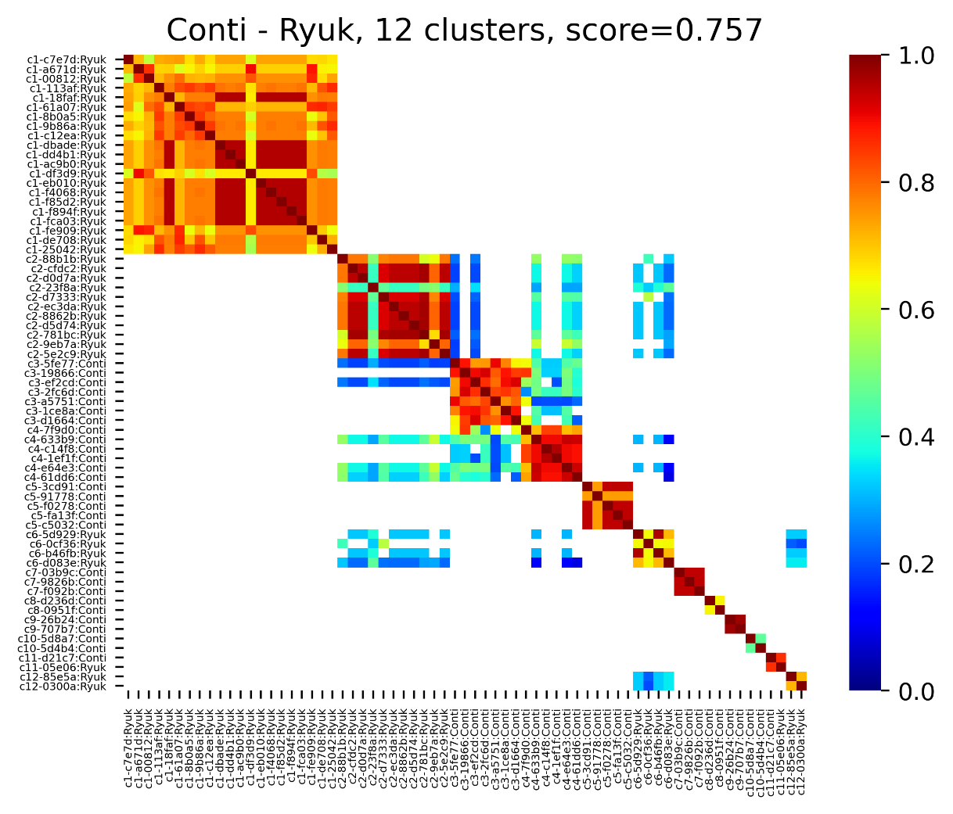
19
Validation of the model
Same persona for developers
Same frameworks of developments
Same implementation of evasion technics

Slide 20
20
Binary analysis automation for a better response

Slide 21
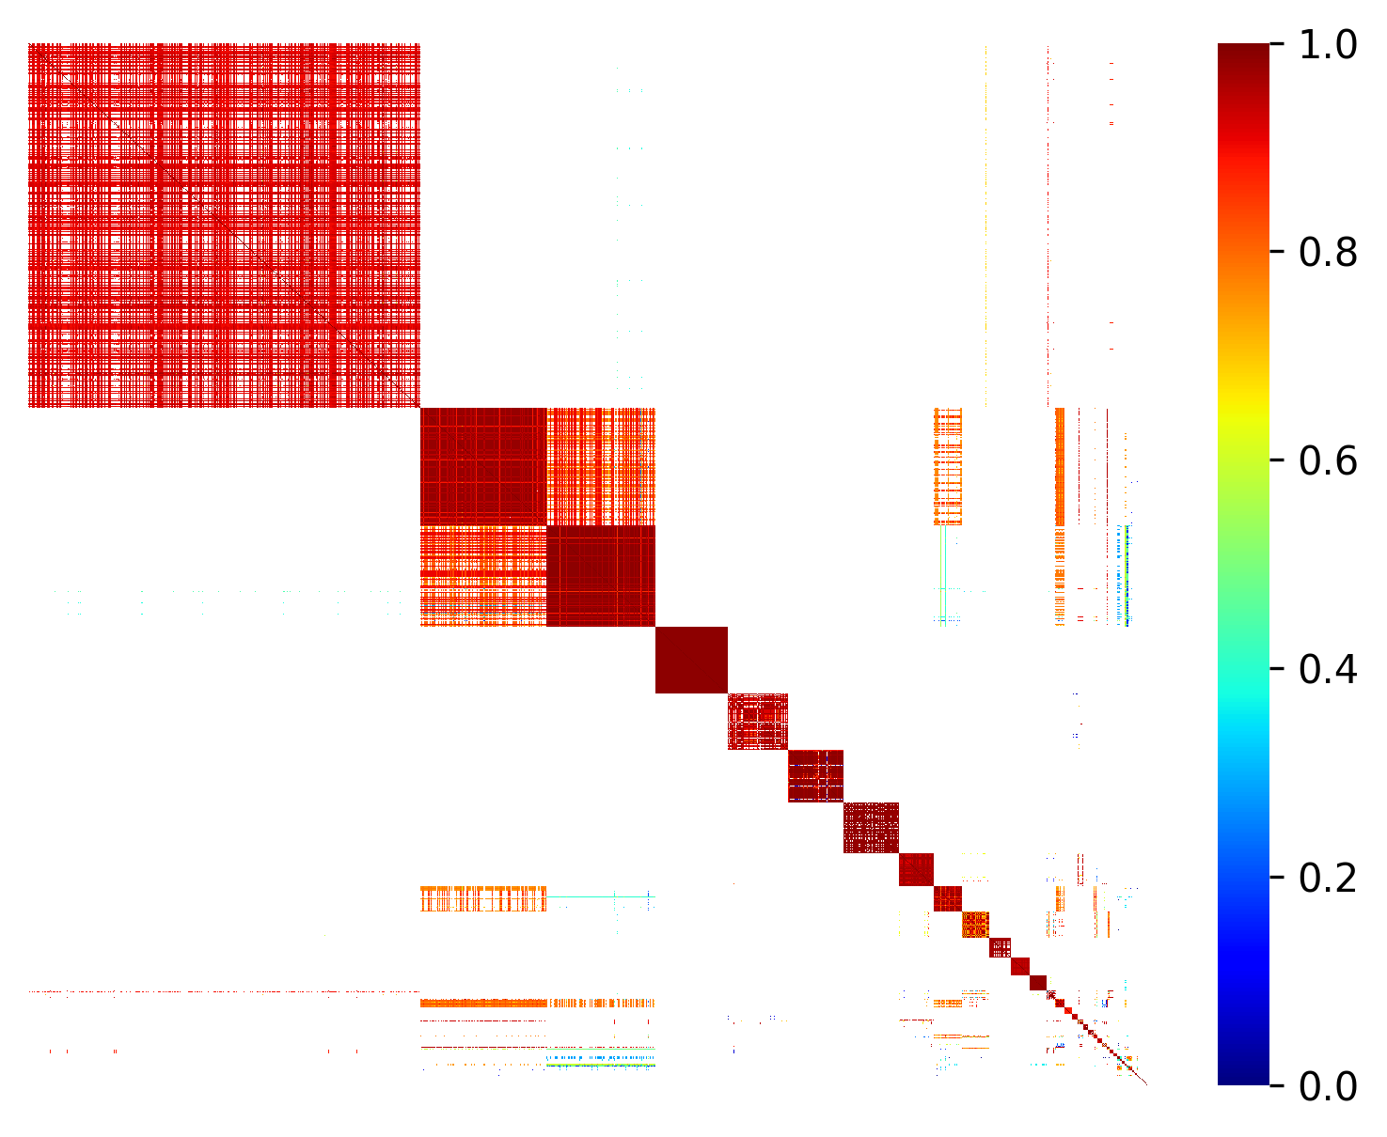
21
Binary analysis automation for a better response

Slide 22
22
Binary analysis automation for a better response
You are here

Slide 23
Thank you.
Marie Salmon – Ingénieure R&D GLIMPS
Sébastien Larinier - Chercheur à l'ESIEA
Frédéric Grelot – Directeur Recherche & Communication GLIMPS

